Slide 1
Manage and Hosting our Web server - (AWS)
Department of Engineering, Computing, and Cybersecurity
Abdul Alqarni
Harmon, Marcus D.
Stokes, Garrett J.
Professor: Dr. Gonzalo D. Parra

Slide 2
Outline
Our Project
The idea of the website
The layout of the website
AWS Service that we used in this project
configuring the web server
CloudWatch
AWS Billing
Conclusion
Resources

Slide 3
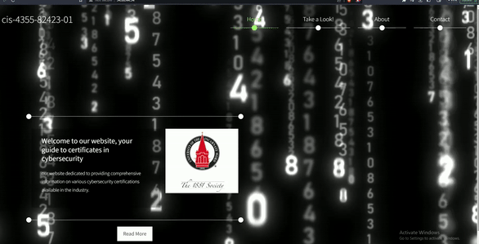
The project is to host and manage our Web site via aws

Slide 4
The idea of the website
The idea of the website is to provided comprehensive information on various cybersecurity certifications available in the industry.

Slide 5
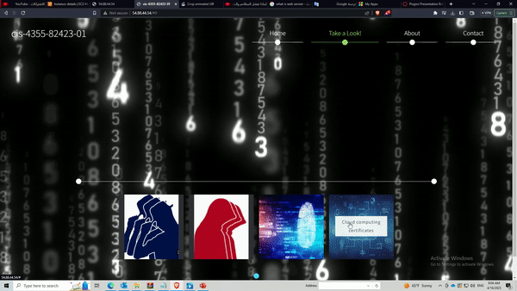
The layout of the website
There is 4 categories on the website that you can chose from.
1-Blue team 2.Red team 3. Digital forensic
4. Cloud computing
By choosing either one ,it will provide you
certifications names and information regarding to your selection

Slide 6
Place your Gantt chart here

Slide 7
Place a screenshot of your Trello board here

Slide 8
Service that we used in this project
IAM
AWS EC2
AWS S3
AWS CloudWatch
AWS Backup
AWS billing

Slide 9
Building and configure the web server “Instance”
Instance details :
-We used Amazon Linux as the image for the Instance
- t2.micro as the instance type
-updating and installing httpd service on the Instance

Slide 10
Creating S3 bucket
After creating the bucket, we upload the website files and store them in the bucket.

Slide 11
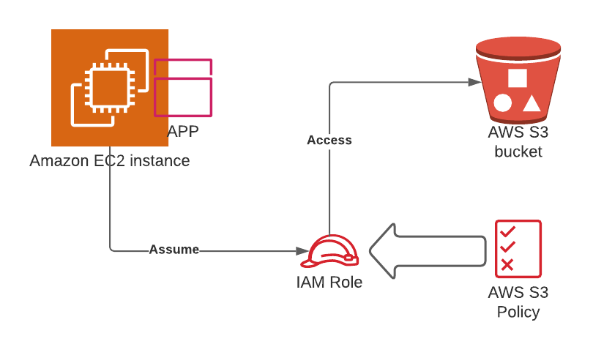
Allow Connection between ec2 and s3 By creating new IAM Role
-We attached the new role that has “AmazonS3FullAccess” policy to our instance
-by doing that , now the instance or the web server have access to download the files from the bucket.

Slide 12
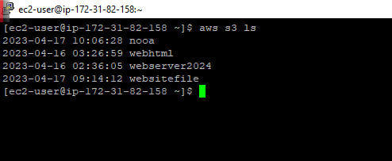
ssh to the instance and use ‘aws s3 ls’ command to check if we have access to the bucket we created.

Slide 13
After we configure the ec2 and s3 we confirmed that the website is live at this point.

Slide 14
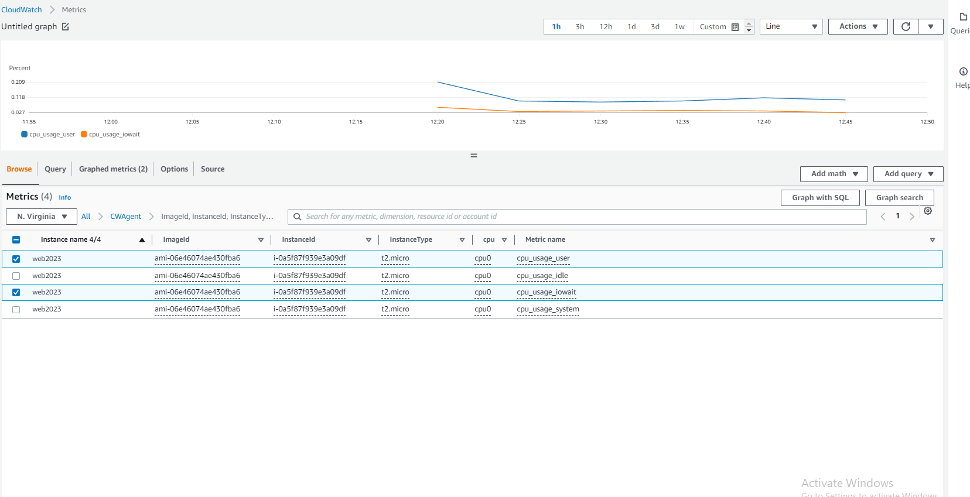
installing AWS CloudWatch Agent on an EC2 instance,
to collect and send system-level metrics, logs, and events, from our instance to Amazon CloudWatch

Slide 15
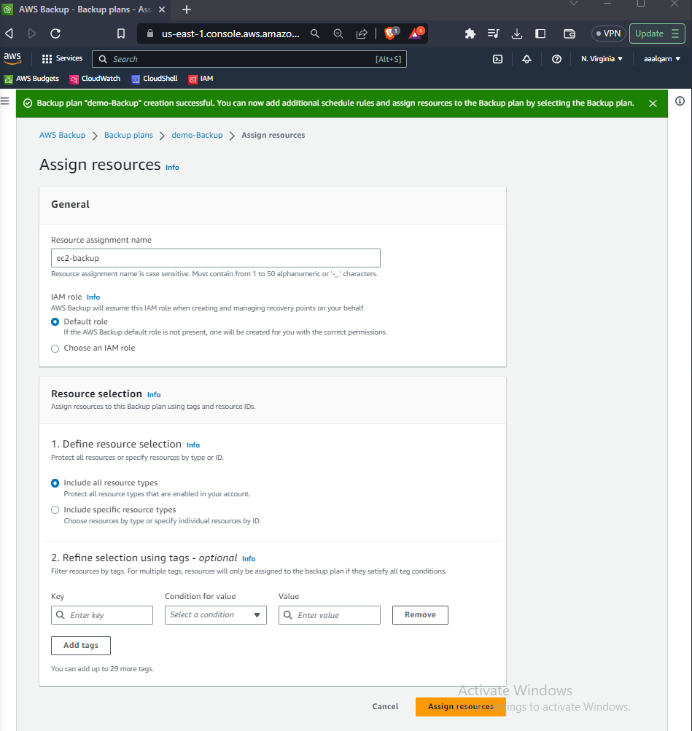
AWS Backup
We created a backup plan that will be automated by using AWS Backup service
And assigned it to the web server ‘instance’.
And the Backup Frequency is Monthly

Slide 16
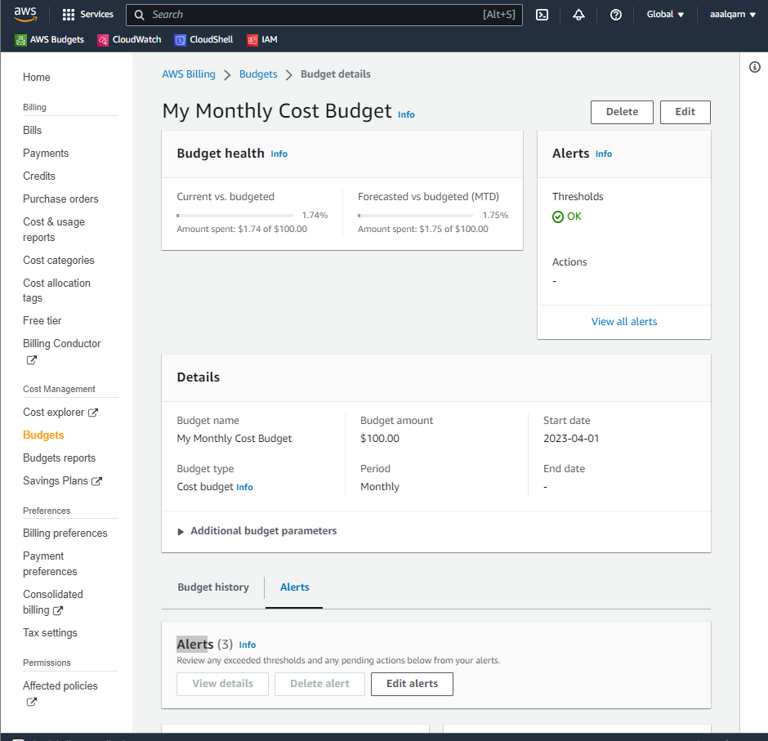
AWS Billing :
we configured and created a Monthly budget also,
will alert us ,before the cost Exceeded the budget

Slide 17
Resources
Website link:http://3.88.144.224/

